Slide 1
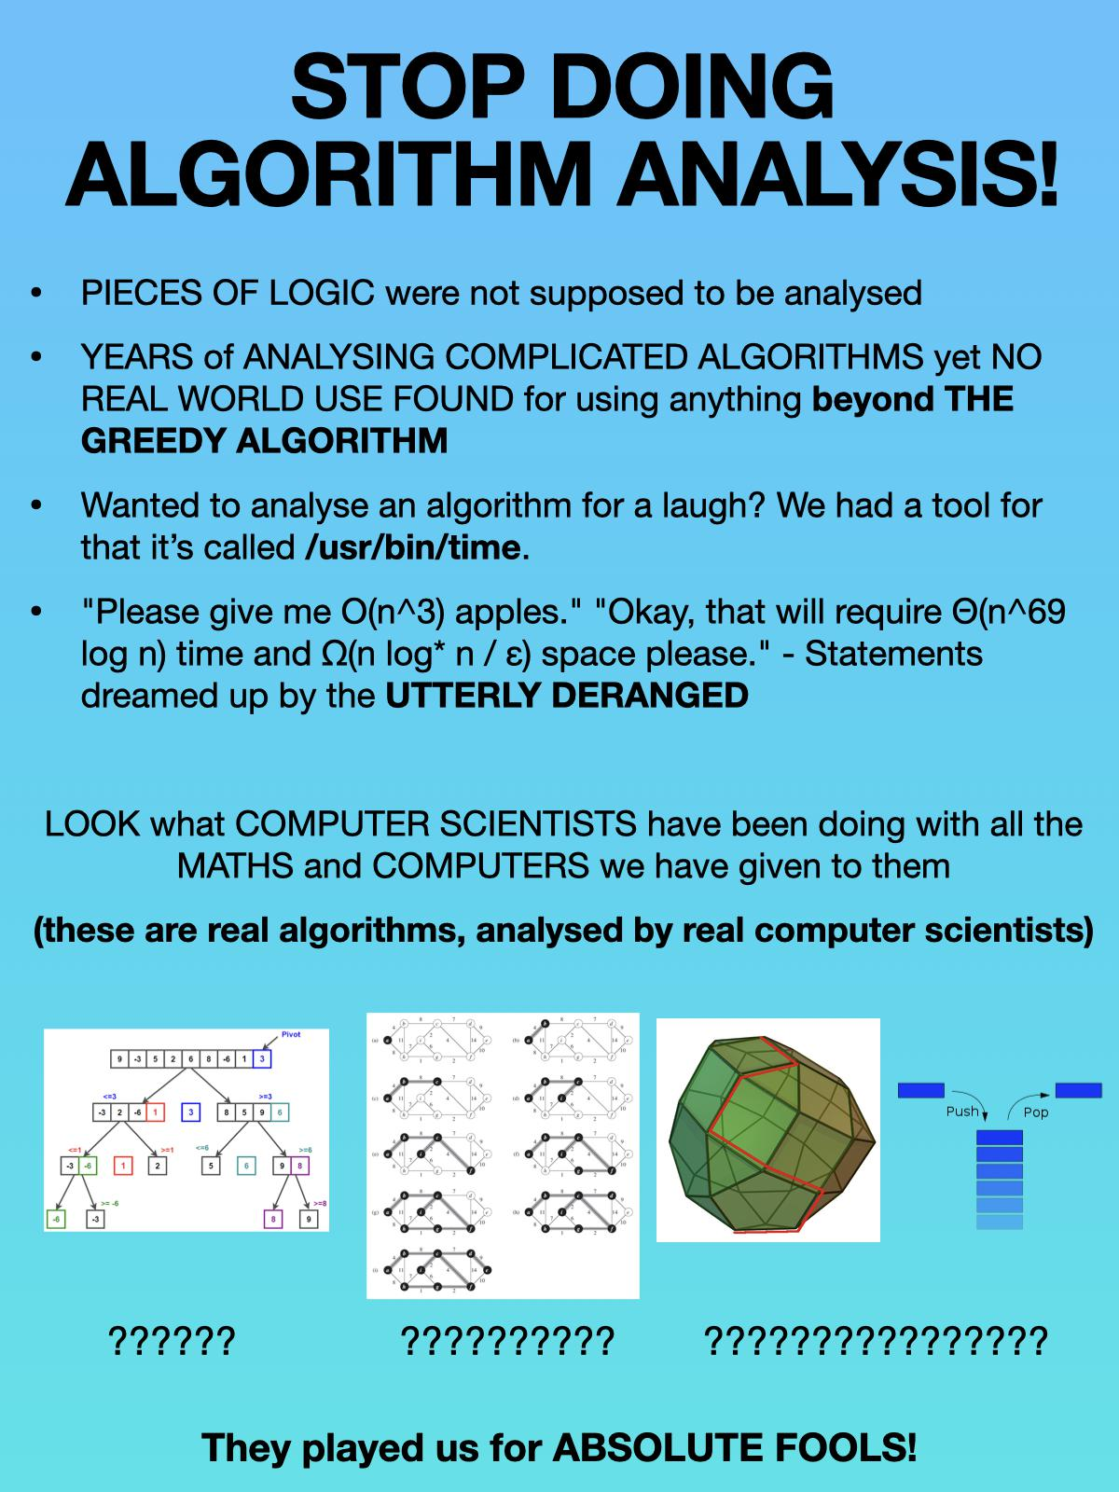
D4: Greedy Algorithms and More DP
Sec 16: Fr 12:30pm-1:30pm FXB 1024
IA: Nick Frieler
Slide deck available at course drive/Discussions/Slides/Nick

Slide 2
Agenda
DP dimensionality
Shortest path DP
  SSSP (Bellman-ford)
  APSP (floyd-Warshall)
Greedy algorithms
  Exchange arguments

Slide 3
DP Dimensionality

Slide 4
More dimensions!?
A lot of the DP examples we have seen so far have been 1-D DP problems
  Fibonacci
  LIS (using END-LIS as an auxiliary DP table)
  Merge-Sort
But wait, there’s more!
Some problems are more naturally suited for multi-dimensional DP tables
  The SugarRush DP table from hw 3
  Contiguous subarrays of an array

Slide 5
Shortest Path DP

Slide 6
Setup for shortest path problems
Weighted directed graph G = (V,E) with a weighted function w: E → R that maps each edge to a weight/cost/length
Individual edges can have negative weight
No negative-weight cycles
  Otherwise the (minimum) distance between some vertices of the graph will not be well-defined

Slide 7
Key observations
If P is a shortest path from s to t that goes through vertex v, then P must be:
  A shortest path from s to v, followed by
  A shortest path from v to t
  (This is a good exercise for proof by contradiction)
Because there are no negative-weight cycles in the graph, if there is a shortest path from s to t, then there is a shortest path from s to t with no cycles
  We call this a simple path because no vertex is visited more than once

Slide 8
Single-source shortest path (SSSP)
Given a source vertex s, find the shortest path from s to every other vertex
  Value version: find the lengths of these shortest paths
Bellman-Ford
  d^{(i)}(s,t) is the length of a shortest path from s to t that uses exactly i edges
  d(s,t) = min{ d⁽¹⁾(s,t), …, d^{(n-1)}(s,t) }
  To calculate d^{(i)}(s,t) we consider d^{(i-1)}(s,u) for all vertices u such that (u,t) is an edge in the graph and add the weight of edge (u,t)

Slide 9
All-pairs shortest paths (APSP)
For every pair of vertices (s,t), find the shortest path from s to t
  Value version: find the lengths of these paths
Floyd-Warshall
  Let v₁, …, v_{n} be a fixed ordering of the vertices of the graph
  d^{[i]}(s,t) is the length of a shortest path from s to t whose internal vertices (if any) are in {v₁, …, v_{i}}
  d(s,t) = d^{[n]}(s,t)
  To calculate d^{[i]}(s,t) we take the minimum of d^{[i-1]}(s,t) and d^{[i-1]}(s,v_{i}) + d^{[i-1]}(v_{i},t)

Slide 10
Greedy Algorithms

Slide 11
Gimme gimme gimme
A greedy algorithm computes a solution to an optimization problem by making a sequence of locally optimal choices
  Cannot “change its mind” about a previously-made decision
In general, no guarantee that a greedy solution is optimal (or even good)
  However, there are scenarios where they are (and we can prove they are optimal!)

Slide 12
Exchange argument recipe
Let ALG = {s₁, s₂, …, s_{m}} denote the (greedy) algorithm’s final output
  Think of these as the choices that the algorithm (greedily) makes
Let OPT be some arbitrary optimal solution
If ALG = OPT, then we’re done
Otherwise ALG ≠ OPT, so there’s some element in ALG that’s not in OPT, call this s_{diff}
Modify OPT so that it remains optimal but contains s_{diff} to get a new optimal solution OPT’
Apply induction on the number of elements in the output where ALG and some optimal solution differ to conclude that there exists some optimal solution that matches ALG fully
  This means ALG is optimal!

Slide 13
Any questions before discussion problems?

Slide 14
Discussion Problems

Slide 15
Q1: Longest Palindromic Subsequence
Give a recurrence relation (including base cases) that is suitable for dynamic programming solutions to the following problem. You do not need to prove your correctness. Given a string S, determine the length of a longest subsequence of S (the characters do not need to be consecutive) that is a palindrome. Recall that a palindrome is a string which is the same forwards and backwards (e.g., “racecar”).

Slide 16
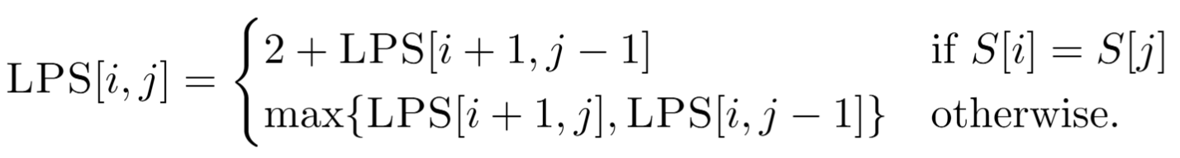
Q1: Longest Palindromic Subsequence
SOLUTION
Give a recurrence relation (including base cases) that is suitable for dynamic programming solutions to the following problem. You do not need to prove your correctness. Given a string S, determine the length of a longest subsequence of S (the characters do not need to be consecutive) that is a palindrome. Recall that a palindrome is a string which is the same forwards and backwards (e.g., “racecar”).

Slide 17
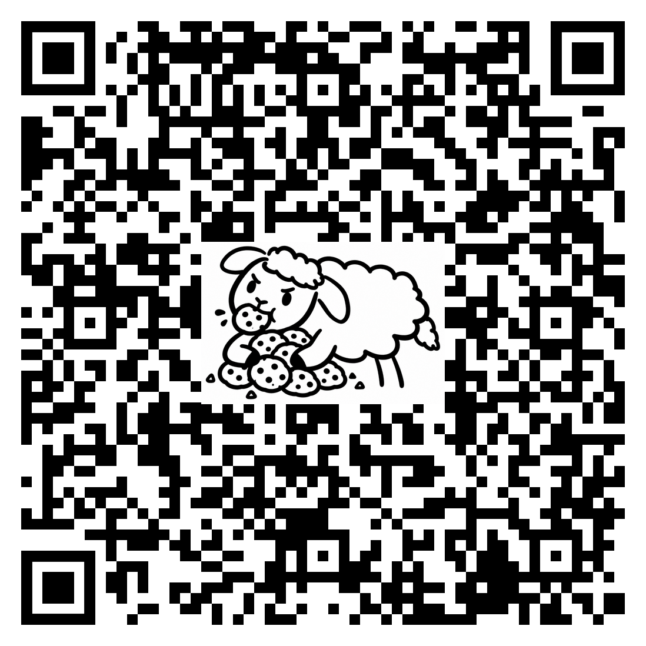
Attendance

Slide 18
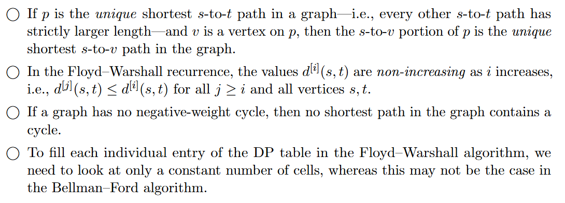
Q2: Bellman-Ford and Floyd-Warshall

Slide 19
Q2: Bellman-Ford and Floyd-Warshall
SOLUTION

Slide 20
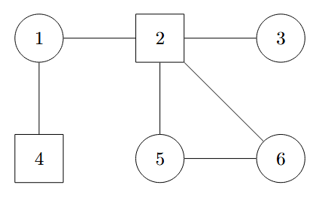
Q3: Dominating sets
A dominating set S in a graph G is a set of vertices for which every vertex of G either is in S, or is adjacent to some vertex in S. We are interested in a smallest dominating set, i.e., one that has the fewest possible vertices. (There may be more than one.)
For example, this graph has a smallest dominating set S∗ = {2,4}: every vertex other than 2 and 4 is adjacent to 2 or 4, and there is no dominating set consisting of a single vertex.

Slide 21
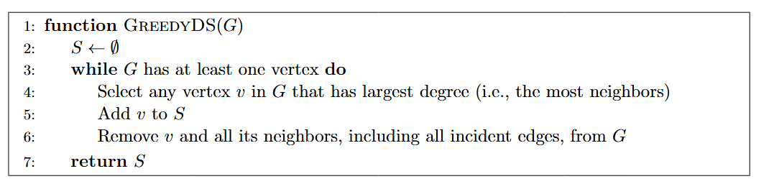
Q3: Dominating sets
Give a small graph G on which this algorithm might not return a smallest dominating
set. Specifically, give a sequence of vertices that the algorithm might choose to make
up its final output set, and give an optimal dominating set of G that is smaller than this
output set.

Slide 22
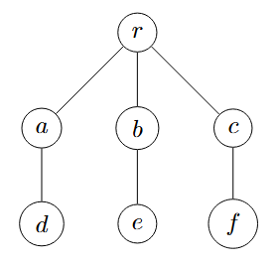
Q3: Dominating sets
SOLUTION

